Slide 1
Models
11 different models tried
Developed in an evolutionary way

Slide 2
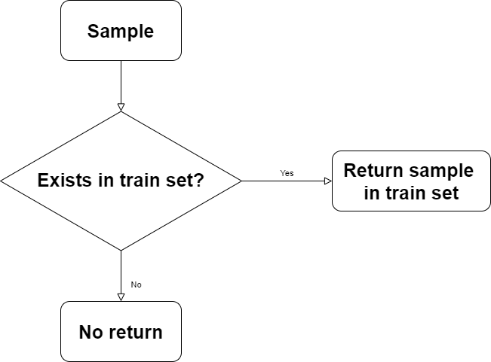
Model 1
MS | H | H (Exact) | H (NiD) | H (NiT) | H (OUFN)
0.1275 | 0.2451 | 0.2235 | 0.000 | NA | 0.1374

Slide 3
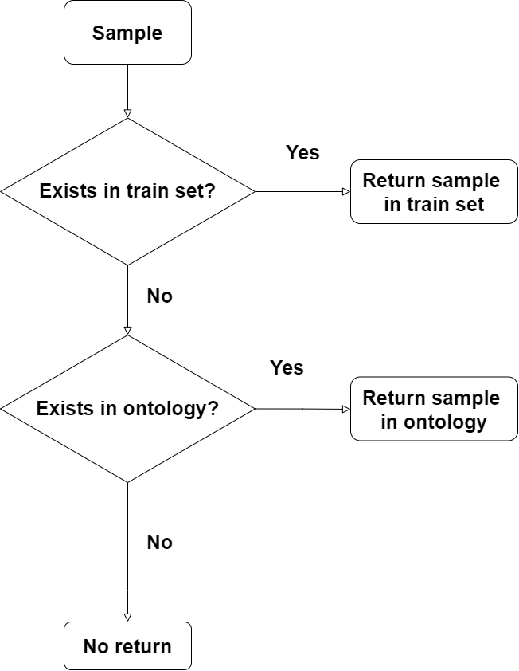
Model 2
MS | H | H (Exact) | H (NiD) | H (NiT) | H (OUFN)
0.1908 | 0.3669 | 0.3448 | 0.2597 | 0.000 | 0.2112

Slide 4
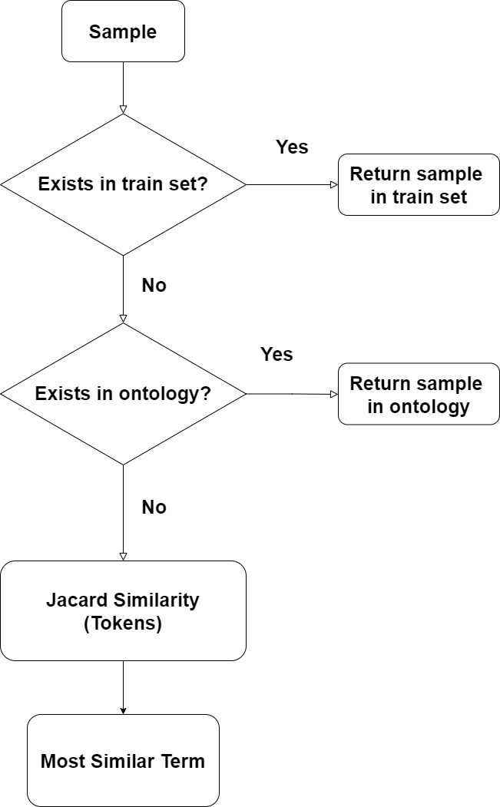
Model 3
MS | H | H (Exact) | H (NiD) | H (NiT) | H (OUFN)
0.3380 | 0.6500 | 0.5320 | 0.4469 | 0.000 | 0.5538

Slide 5
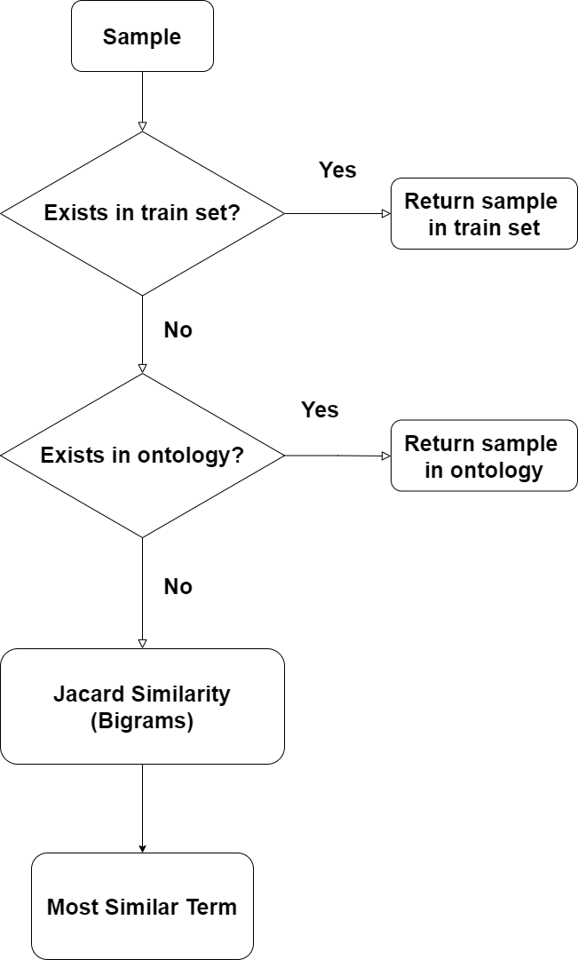
Model 4
MS | H | H (Exact) | H (NiD) | H (NiT) | H (OUFN)
0.3665 | 0.7047 | 0.5784 | 0.5154 | 0.000 | 0.6168

Slide 6
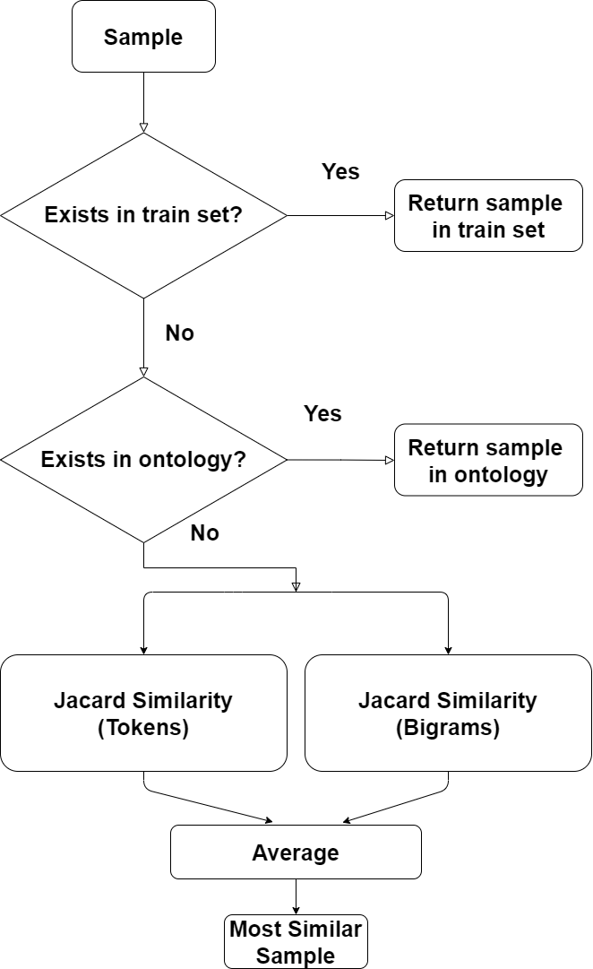
Model 5
MS | H | H (Exact) | H (NiD) | H (NiT) | H (OUFN)
0.3819 | 0.7344 | 0.6121 | 0.5169 | 0.000 | 0.6547

Slide 7
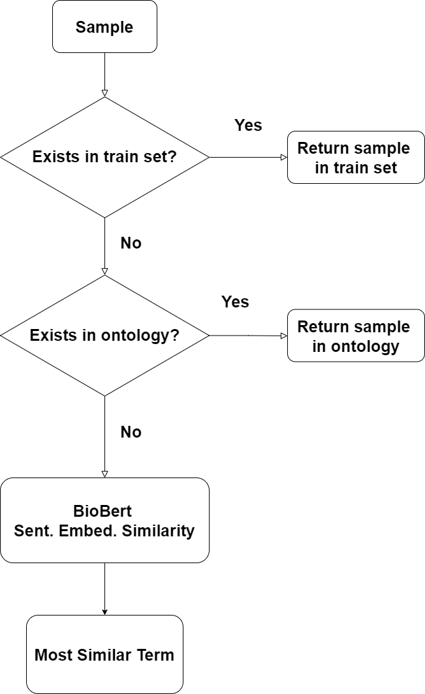
Model 6
MS | H | H (Exact) | H (NiD) | H (NiT) | H (OUFN)
0.3409 | 0.6555 | 0.4639 | 0.3135 | 0.000 | 0.5908

Slide 8
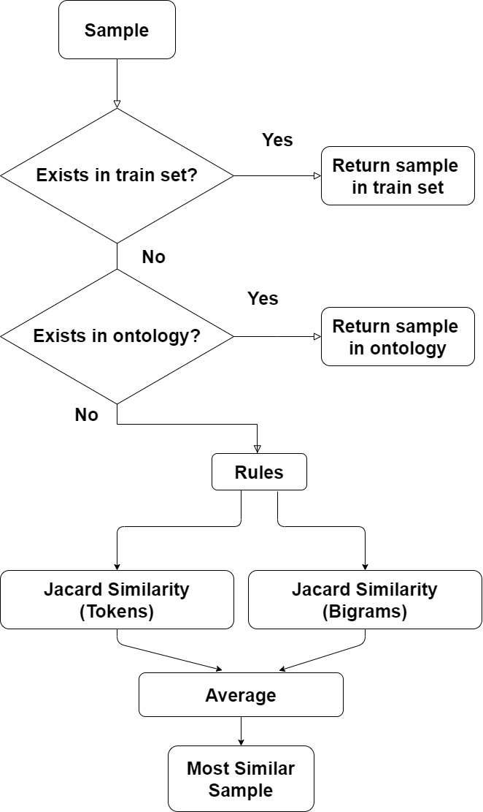
Model 7
MS | H | H (Exact) | H (NiD) | H (NiT) | H (OUFN)
0.4071 | 0.7829 | 0.6651 | 0.6202 | 0.000 | 0.7310

Slide 9
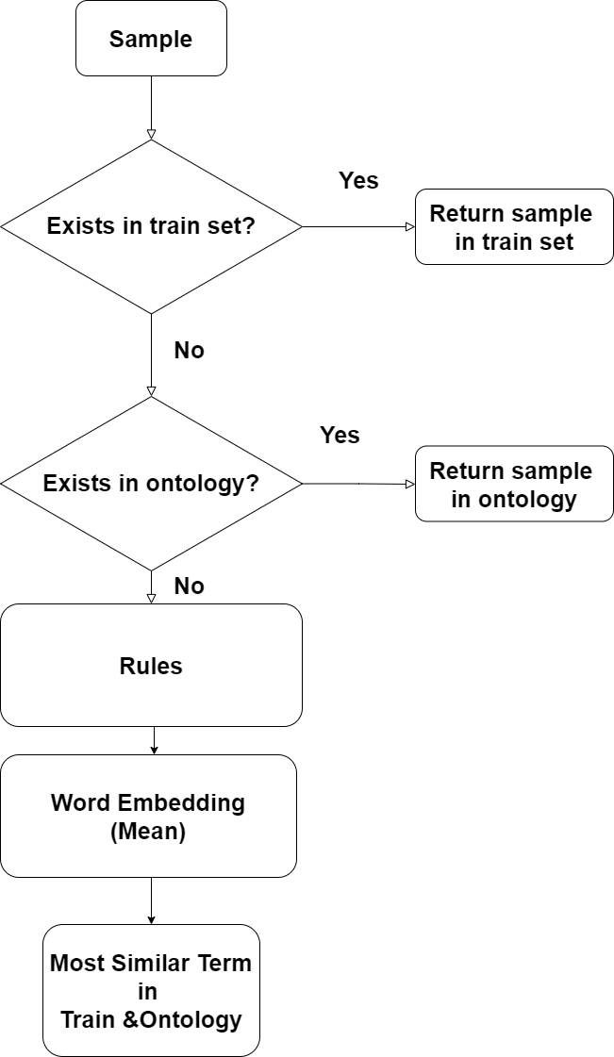
Model 8
 | MS | H | H (Exact) | H (NiD) | H (NiT) | H (OUFN)
Dev | 0.4281 | 0.8233 | 0.6951 | 0.6443 | 0.0000 | 0.7732
Test(*) | 0.3673 | 0.7219 | 0.5487 | 0.4906 | 0.09639 | 0.6962

Slide 10
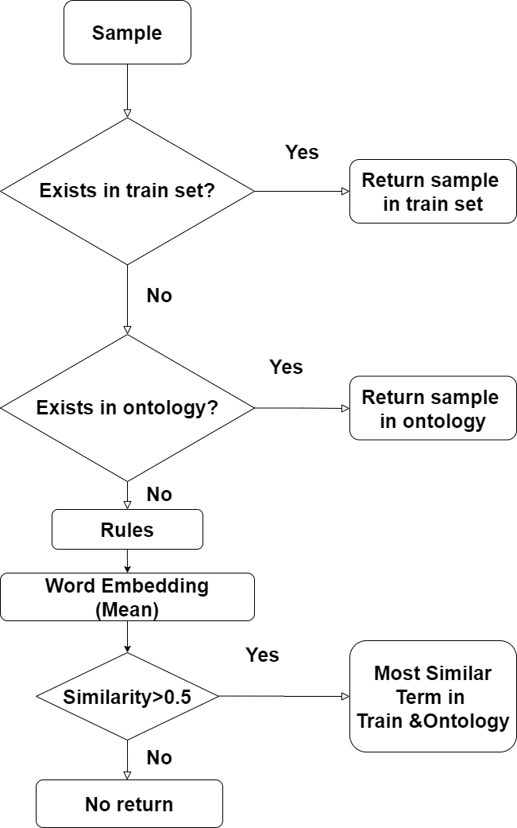
Model 9
MS | H | H (Exact) | H (NiD) | H (NiT) | H (OUFN)
0.4276 | 0.8222 | 0.6951 | 0.6443 | 0.000 | 0.7714

Slide 11
Overall Progress
Alg. | Set | MS | H | H (Exact) | H (NiD) | H (NiT) | H (OUFN)
EMT | Dev | 0.1275 | 0.2451 | 0.2235 | 0.000 | NA | 0.1374
EMTO | Dev | 0.1908 | 0.3669 | 0.3448 | 0.2597 | 0.000 | 0.2112
EMTO JT | Dev | 0.3380 | 0.6500 | 0.5320 | 0.4469 | 0.000 | 0.5538
EMTO JBi | Dev | 0.3665 | 0.7047 | 0.5784 | 0.5154 | 0.000 | 0.6168
EMTO JA | Dev | 0.3819 | 0.7344 | 0.6121 | 0.5169 | 0.000 | 0.6547
EMBB | Dev | 0.3409 | 0.6555 | 0.4639 | 0.3135 | 0.000 | 0.5908
EMTO JAR | Dev | 0.4071 | 0.7829 | 0.6651 | 0.6202 | 0.000 | 0.7310
EMTO RWE (*) | Dev | 0.4281 | 0.8233 | 0.6951 | 0.6443 | 0.0000 | 0.7732
EMTO RWET | Dev | 0.4276 | 0.8222 | 0.6951 | 0.6443 | 0.000 | 0.7714
EMTO RWE (*) | Test | 0.3673 | 0.7219 | 0.5487 | 0.4906 | 0.09639 | 0.6962
+2 models: TF-IDF & POS Tagging (Headword), didn’t improve results

